Slide 1
Sub:
CACD
Skill-5
Implementation of Password Cracking Using John The Ripper

Slide 2

Skill-5
Implementation of Password Cracking Using John The Ripper
Sub:
CACD
So Now We Will Be Working On John The Ripper
What Is John The Ripper ?
So Basically John The Ripper Is A Free Password Cracking Software Tool Usually Used During Pentesting Exercises That Can Help IT Staff Spot Weak Passwords And Poor Password Policies
John The Ripper Uses Two Types Of Attacks
Dictionary Attack → String samples are essentially taken from a specific wordlist, text file, a dictionary, or past cracked passwords
Brute Force Attack → All possible plaintexts composed of usernames with encrypted passwords are all exhausted to find the right one
Rainbow Tables → A pre-computed password hashes Is compared against existing data dump to find correct password in its plaintext form
John The Ripper Uses Three Types Of Modes
Single Crack Mode → uses information from UNIX passwd files[passwd/shadow] files to guess passwords
Wordlist Mode → It relies on the user providing a text file with a list of passwords, ideally one per line and no duplicates
Incremental Mode → this mode will never terminate As number of combinations being too large And Uses All combinations To Crack
Warning:
Cracking Passwords Of Whatever Files You Like Might Lead You To The Risk, So You Better Be Careful Before Decrypting Anything That You Don’t Have Permission To
Be Anonymous, Be Safe

Slide 3
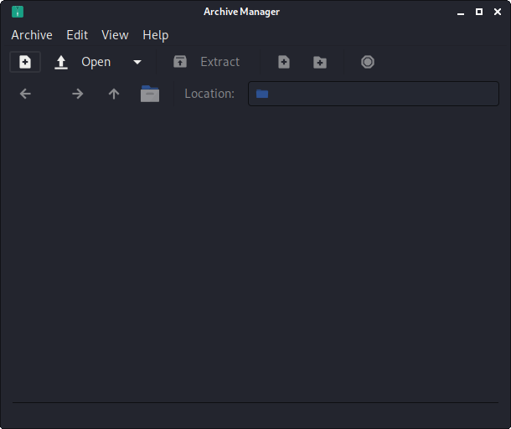

Skill-5
Implementation of Password Cracking Using John The Ripper
Sub:
CACD
Engrampa Archive Manager
Encrypted Zip File Creation
Note: You Could Create Your Own Encrypted Zip File Using Engrampa Archive Manager Or Download A Temporary Encrypted File From Here: bit.ly/skill5zip

Slide 4

Skill-5
Implementation of Password Cracking Using John The Ripper
Sub:
CACD
Engrampa Archive Manager
Open Engrampa Archive Manager To Create A Encrypted Zip File

Slide 5
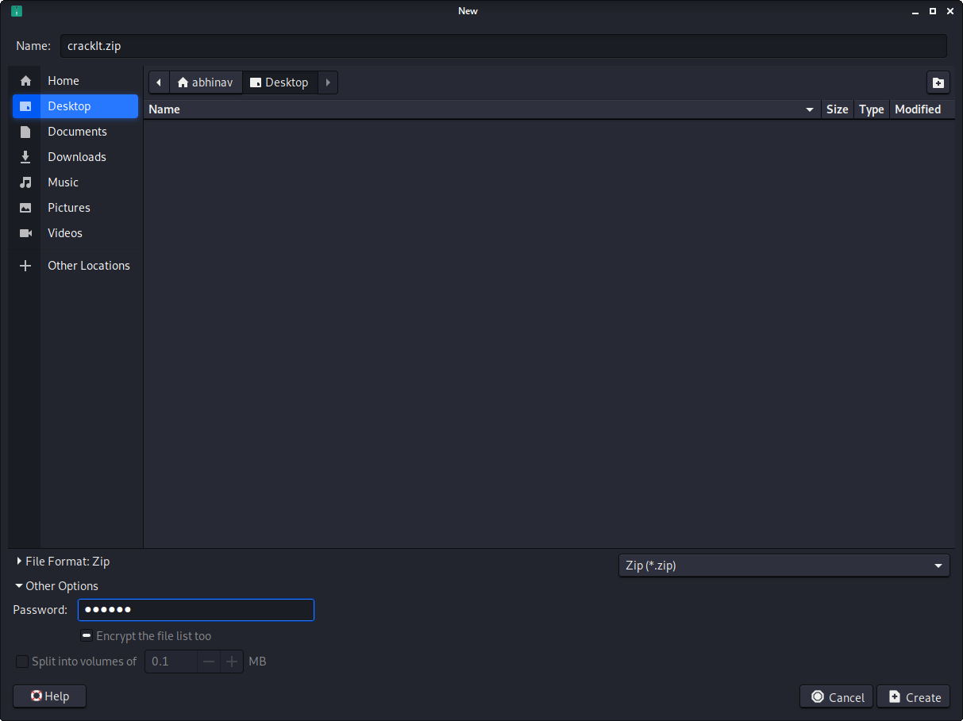
Skill-5
Implementation of Password Cracking Using John The Ripper
Sub:
CACD
Engrampa Archive Manager
Create A New Archive With .zip Format And Enter A Password[In My Case The Password Is qwerty] In Other Options Section And Save It In Your Desired Path

Slide 6
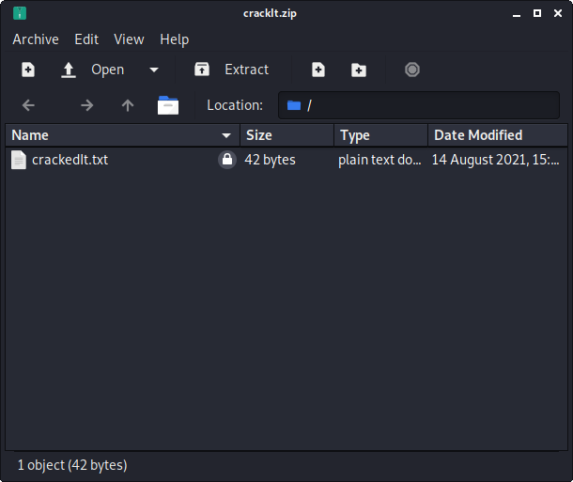
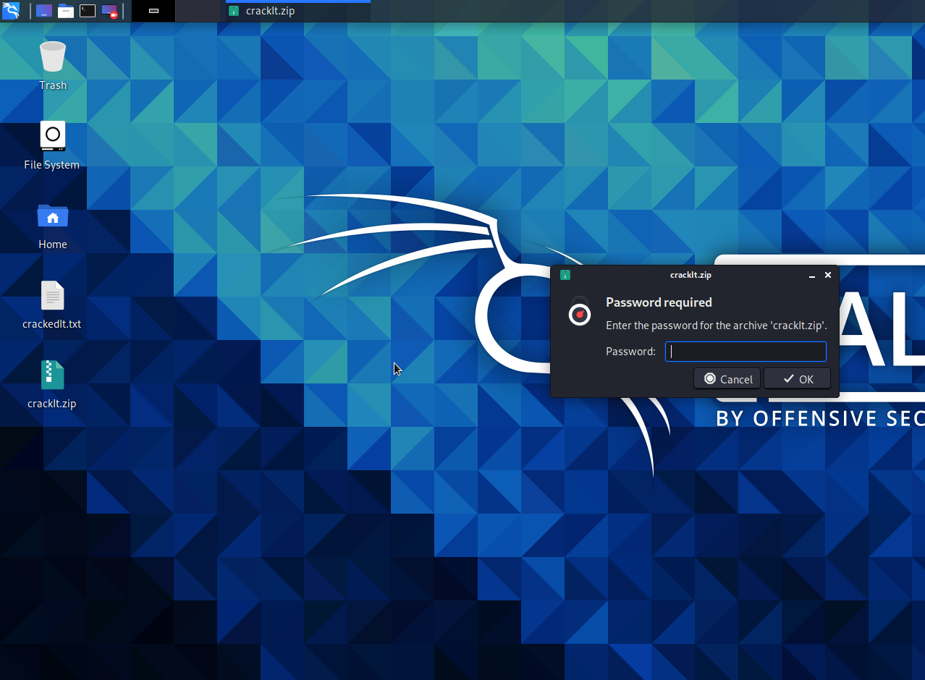
Skill-5
Implementation of Password Cracking Using John The Ripper
Sub:
CACD
Engrampa Archive Manager
After Successfully Setting Up A Zip File With Password Encrypted, Try Adding Any Of The File In It So The Zip File Is Created In The Selected path

Slide 7

Skill-5
Implementation of Password Cracking Using John The Ripper
Sub:
CACD
Engrampa Archive Manager
Hurray..!!!!!!!!
Successfully Done Up Creating The Encrypted Zip File. Now Let’s Go With Cracking That Zip File Password

Slide 8
Skill-5
Implementation of Password Cracking Using John The Ripper
Sub:
CACD
John The Ripper
Cracking The Password Of The Encrypted Zip File

Slide 9
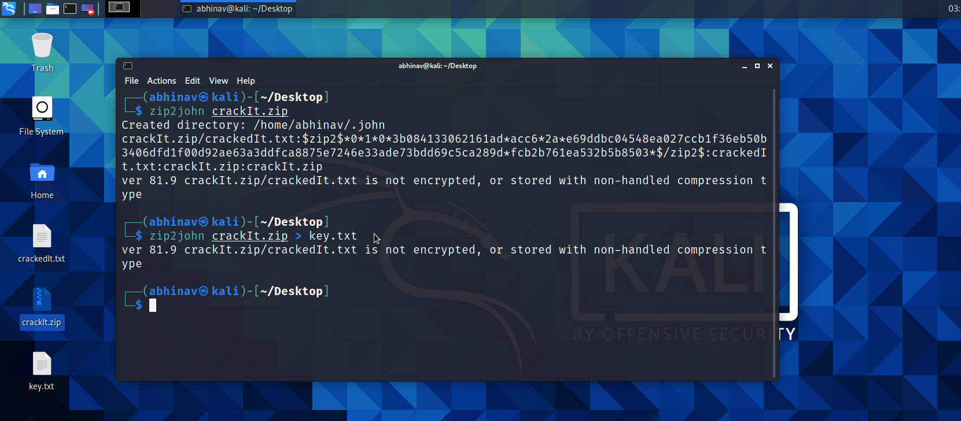
Skill-5
Implementation of Password Cracking Using John The Ripper
Sub:
CACD
John The Ripper
Now Open A Terminal At The Same Path Where You Saved The Encrypted Zip File Is Present
Type “zip2john [zip-File-Name].zip” To See The Hash Generated
Type “zip2john [zip-File-Name].zip > [text-File-Name].txt” To Save The Hash Generated In The Text File

Slide 10
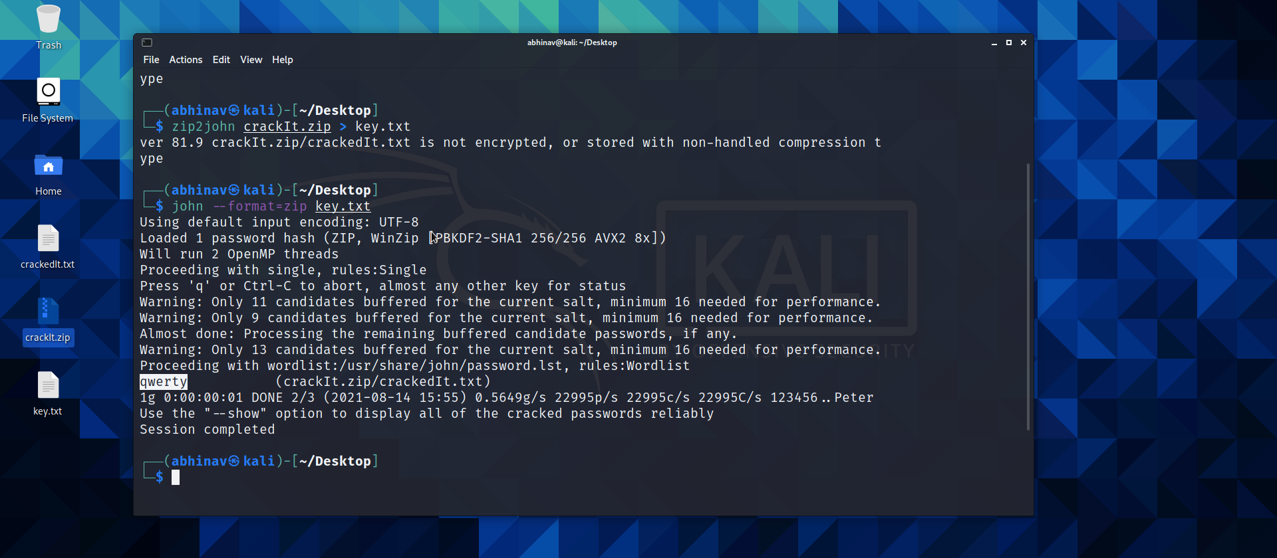
Skill-5
Implementation of Password Cracking Using John The Ripper
Sub:
CACD
John The Ripper
Now In The Next Line Use The Below Command To Get The Password Of The Zip File Using The Hash You Just Stored In The Text File
Type “john --format=zip [text-File-Name].txt” To Get The Password Of The Zip File

Slide 11


Skill-5
Implementation of Password Cracking Using John The Ripper
Sub:
CACD
John The Ripper
Now Let’s Check If We Can Extract The Files From The Encrypted Zip File Using The Password Cracked By John The Ripper

Slide 12


Skill-5
Implementation of Password Cracking Using John The Ripper
Sub:
CACD
John The Ripper
Yeah Cool, We Have Successfully Cracked Up The Password Using John The Ripper Tool

Slide 13
Skill-5
Implementation of Password Cracking Using John The Ripper
Sub:
CACD
Pros Of John The Ripper:
If The Password Of The File You Are Trying To Crack Is In The Dictionary File It Is Using, Then The Time For Password Cracking Is Very Quick
John The Ripper Uses Many Approaches To Crack Password, Even If Cracking Password Fails In First Mode It Moves On To The Second Mode

Slide 14
Skill-5
Implementation of Password Cracking Using John The Ripper
Sub:
CACD
Cons Of John The Ripper:
Basically, John The Ripper Uses The Basic And Most Common Passwords Wordlist
But If You Got A Zip File Containing Complex Password, To Crack It You Should Input A Different Third-Party Or Self-Made Wordlist
Once The Hash Is Cracked, If You Run It Again On The Same File – The John The Ripper Outputs You That The Password Hash Is Cracked
If The Password Is To Be Cracked By Brute Force, Then John The Ripper Takes So Long TIme

Slide 15

Skill-5
Implementation of Password Cracking Using John The Ripper
Sub:
CACD
John The Ripper
Boooom..!!!!!!!!
We Have Successfully Cracked The Password Of The File, Now It’s Your Path On How To Use This….!!!!
Warning: Hacking Is Illegal, Do It On Your Own Risk

